Slide 1
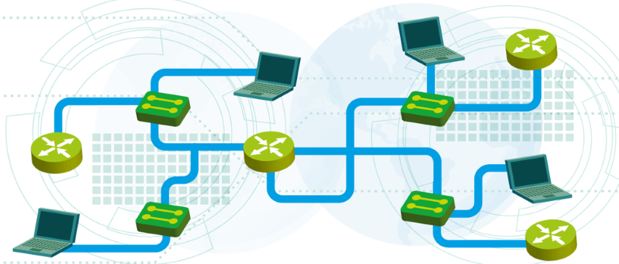
Course summary
Lecture 8
SoftUni Team
Technical Trainers
Software University
http://softuni.bg

Slide 2
Table of Contents
Lecture 1: Introduction to networking
Lecture 2: IP addresses and host-to-host communication
Lecture 3: Network access, security and VLANS
Lecture 4: Layer 2 redundancy – STP
Lecture 5: IP services and basic routing
Lecture 6: Dynamic routing with OSPF
Lecture 7: Practice – Demonstrations with physical devices

Slide 3
Lecture 1: Introduction to networking

Slide 4
How did it start?
ARPANET - The Advanced Research Projects Agency NETwork
Established in 1969
It is the first packet switching network which will use TCP/IP
It was designed for scientific purposes and to share computer resources
ARPANET’s purpose was more academic than military

Slide 5
Common Types of Computer Networks
Local Area Network (LAN)
Wide Area Network (WAN)
Wireless Local Area Network (WLAN)
Storage Area Network (SAN)
Home Area Network (HAN)

Slide 6
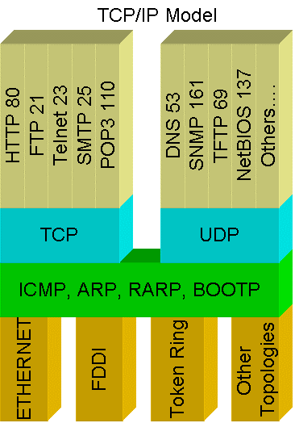
Networks Protocols
Define a common format and set of rules for exchanging messages between network devices
Common protocols:
HTTP
FTP
SMTP
DNS
DHCP
RDP

Slide 7
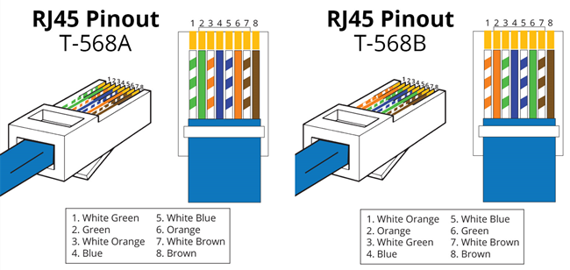
EIA/TIA Standards
EIA = Electronic Industries Alliance TIA = Telecommunications Industry Association
T568B is most frequently used

Slide 8
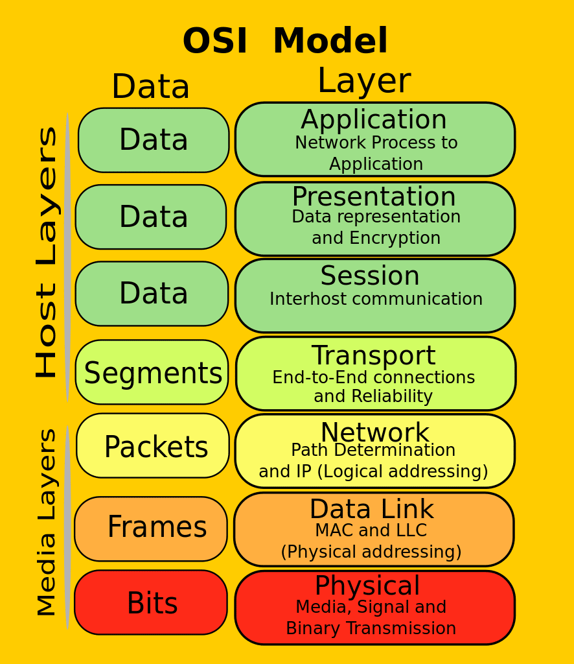
OSI Model
OSI = Open Systems Interconnection
Why?
Organizes the information
Simplifies learning
Standards for the vendors
Easier troubleshooting
Protocol Data Unit (PDU) – different data format at each layer

Slide 9


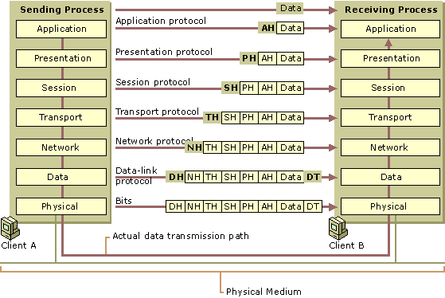
Data Flow in the OSI Model

Slide 10
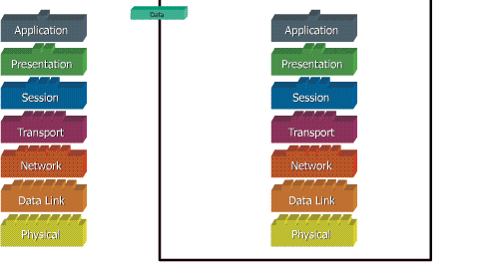
Data Flow in the OSI Model (2)

Slide 11
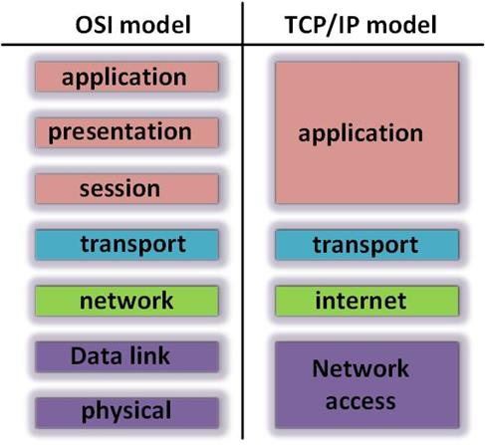
OSI and TCP/IP Models Comparing

Slide 12
Lecture 2: IP addresses and host-to-host communication

Slide 13
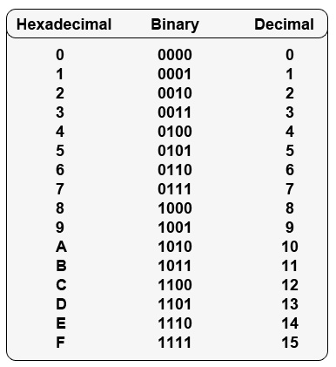
Different numeral systems
Common Numeral Systems in computer networking:
Decimal
Binary
Hexadecimal

Slide 14
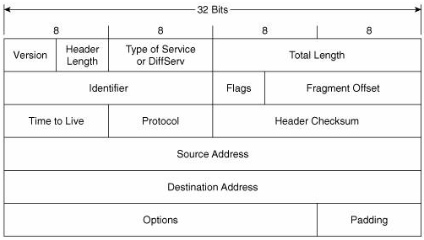
IPv4 Address
Plays important role for device connectivity
It is a 32-bit address
There are 4 294 967 296 IP addresses (2³²)

Slide 15
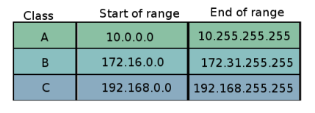
Private IP addresses
Used for addressing internal networks (offices, HQs etc.)
Not routable on the Internet
Can be reused in many networks
Range of private addresses for each class (classes are discussed later)

Slide 16
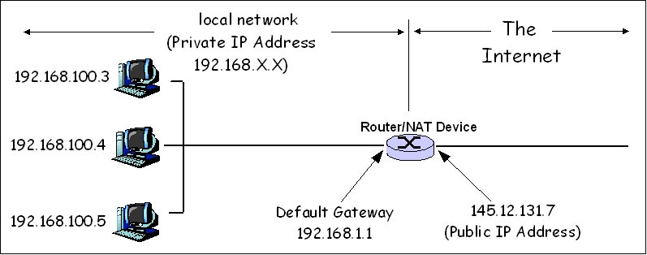
NAT – Network address translation

Slide 17
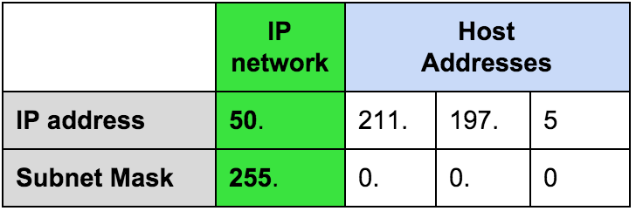
Network masks
Define the border between the network and the hosts part
Segment the network

Slide 18
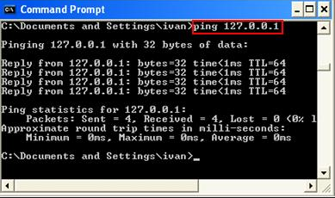
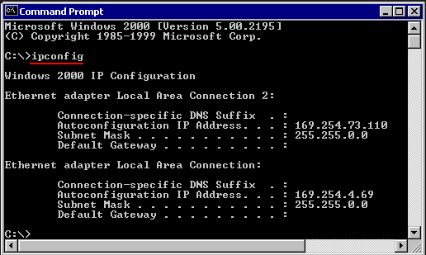
Reserved/Special IP Addresses
There are some special IP addresses. For example:
127.0.0.1 /8
Known as loopback address
On most computer systems, “localhost” resolves to the IP address 127.0.0.1
169.254.X.X /16
When DHCP is not reachable
Known as APIPA (Microsoft)

Slide 19
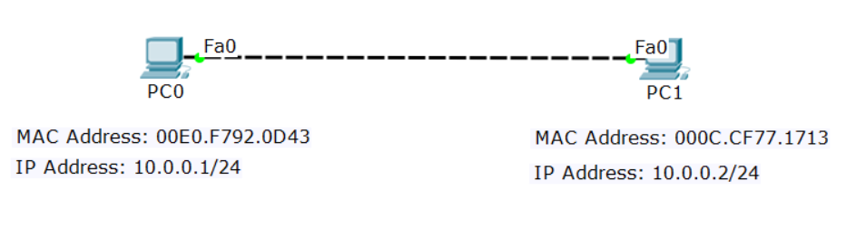
Four addresses required
There are 4 addresses needed for Ethernet communication:
Source IP | Destination IP
Source MAC | Destination MAC

Slide 20
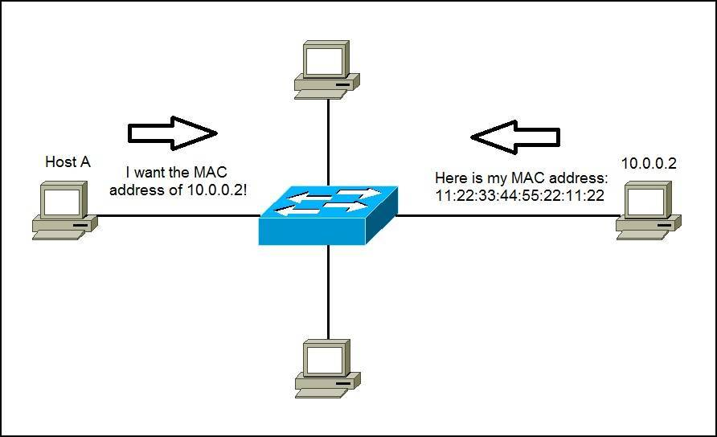
ARP: Address Resolution Protocol
Used to find the MAC address of the destination
Uses Broadcast

Slide 21
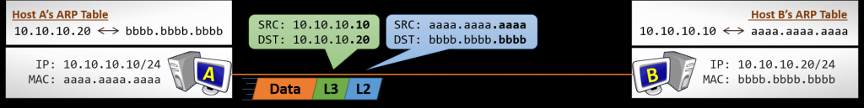
Direct communication (without router)
Source and destination MAC addresses are constant
Source and destination IP addresses are constant

Slide 22
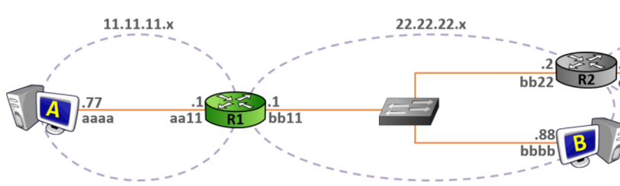
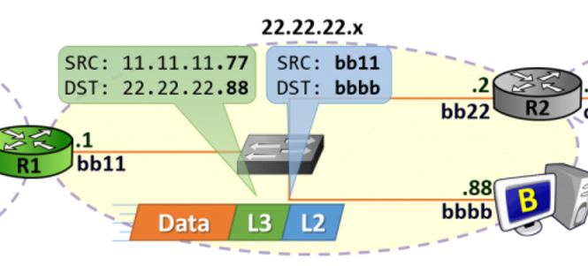
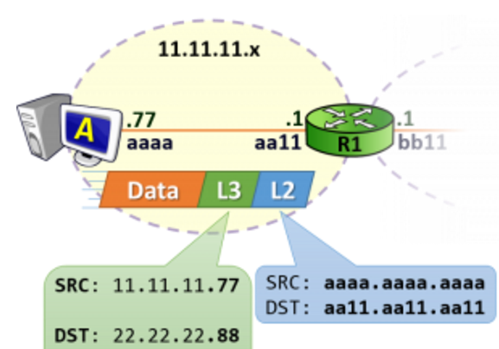
Host-to-Host Communication With Routers

Slide 23
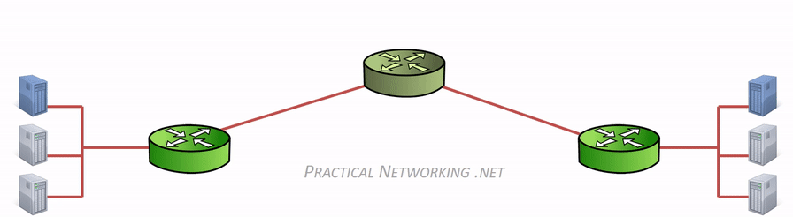
Host-to-Host Communication With Routers (2)
Source and destination MAC addresses are changed at every hop/router

Slide 24
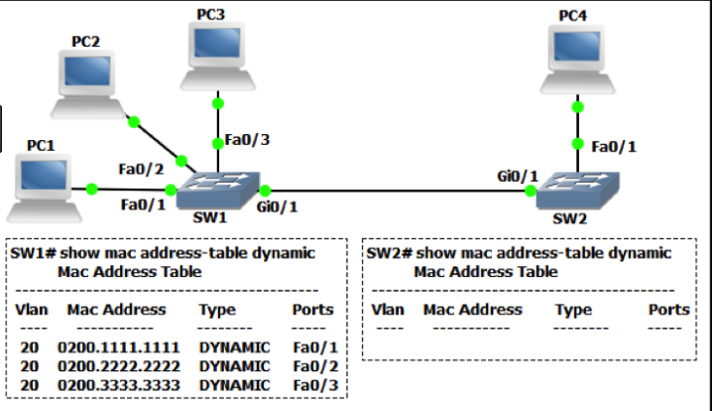
The MAC address table
It is a (dynamic) table that maps MAC addresses to ports
Used to find the proper interface when the switch forwards a packet

Slide 25
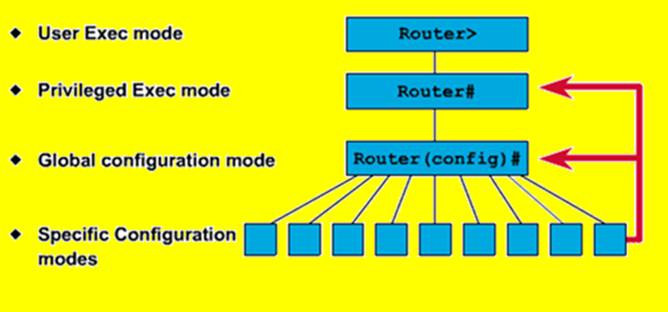
Command Line Introduction
Different vendors use different names but the logic is similar
Typical CLI modes:
Read-only (User)
Read-write (Privilege)
Configuration (Global config)
Sub-configuration

Slide 26
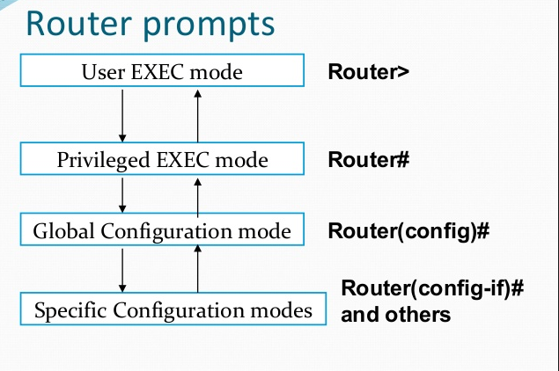
Command line
type “enable”
type “configure terminal”
Interface, VLAN, routing, etc.
to go back, type “exit”

Slide 27
Basic Connectivity Checks
Ping (Layer 3)
Traceroute (Layer 3)
LLDP (Layer 2)
CDP (Layer 2)

Slide 28
Lecture 3: Network access, security and VLANS

Slide 29
Saving the configuration
The configuration file must be saved to survive reboot
To save the running configuration file (stored in RAM) to the startup configuration file (stored in NVRAM), use either:
copy run start
write memory
configuration
changes
running config
startup config

Slide 30
Loading the configuration
The saved configuration file (startup config file) will go in the RAM (the running config file) when:
the device is restarted
a copy start run command is executed
running config
startup config

Slide 31
Out-of-band vs in-band management
Out-of-band:
Management traffic uses separate path from the user traffic
Typical protocol: Console
In-band management
Management traffic travels the same path as user traffic
Typical protocols: Telnet, SSH, SNMP, Web

Slide 32
Secure access - best practices
Physically secure the devices
Use SSH instead of Telnet
Use SNMPv3 instead of v1 or v2
Use HTTPS instead of HTTP
Out-of-band management (console) is considered more secure than in-band management
Create strong passwords for each privilege level and method of access (console, VTY)

Slide 33
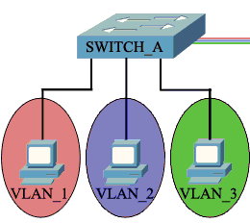
Access (untagged) ports
Used to connect to end-user devices
Can be associated with only one VLAN
Uses the “normal” ethernet frame where there is no VLAN information - no VLAN tag

Slide 34
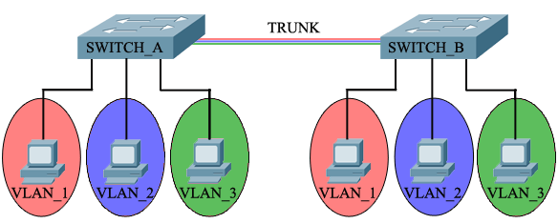
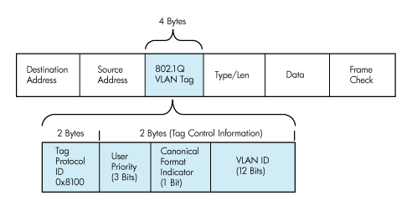
Trunk (tagged) ports
Used to connect between switches
Can carry information from/to multiple VLANs
Uses the 802.1Q tagged frame

Slide 35
Tagging between switches
VLAN 2
Untagged
Untagged

Slide 36
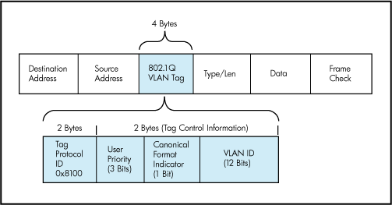
Trunk port details
Uses IEEE 802.1Q tag to identify each frame
A trunk carries multiple tagged VLANs and (maximum) one untagged VLAN
The untagged VLAN on a trunk is called:
Native VLAN (Cisco)
PVID (HPE Comware)
Untagged VLAN (HPE Provision)

Slide 37
Lecture 4: Layer 2 redundancy - Spanning Tree Protocol

Slide 38
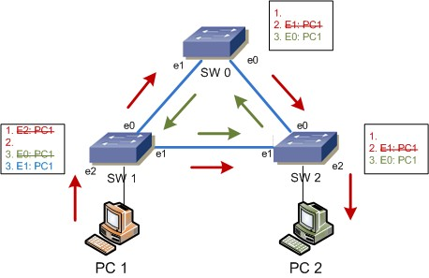
What is the Spanning Tree Protocol?
It addresses a problem which switches can not handle alone: the broadcast storms
Without STP, a L2 loop will:
Overload the links
Affect the end devices
Cause MAC table instability
…never stop

Slide 39
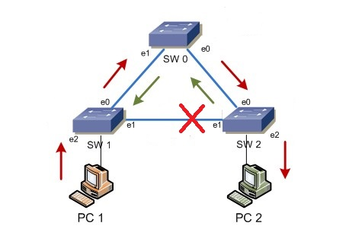
What is the Spanning Tree Protocol? (2)
All STP enabled switches “talk” to each other
The management information that they exchange is in the form of BPDUs (Bridge Protocol Data Units)
The goal is to logically block one or more ports to prevent from loops

Slide 40
The STP algorithm
Elect the Root switch (Root bridge)
This is the switch with the lowest BID (Bridge ID)
BID = Switch Priority and MAC
Select the root ports
They have the best cost (lowest) to the Root
Selected per switch
Select the designated ports
They have the best cost (lowest) to the Root
Selected per segment (connection)
All other ports go to blocking state

Slide 41
STP tie-breakers
If there is a tie situation - the same path cost via different paths, use the following tie-breakers:
When selecting Root port or Designated port, chose the neighboring switch which has the lowest Bridge ID
If the Bridge ID is the same, select the lowest Port ID (PID)
Port ID = Port priority and port number

Slide 42
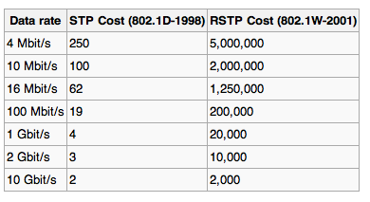
Link costs (path cost)
Higher port speed -> lower cost
The values can be changed by administrator

Slide 43
STP Priority
A number between 0 and 61440
Must be configured in increments of 4096
Default is 32768 (+ the VLAN ID)
The switch with the lowest priority will become the Root
If equal values -> lowest MAC address wins (BID = Priority and MAC)

Slide 44
Spanning Tree Protocol – Main Flavors
STP - Spanning Tree Protocol, IEEE 802.1D
RSTP - Rapid STP, IEEE 802.1W
MSTP - Multiple STP, IEEE 802.1S (802.1Q-2005)
PVST+ - Per-VLAN STP, Cisco proprietary

Slide 45
PVST+
Per-VLAN Spanning Tree is Cisco protocol
Why? It has a similar idea as MSTP -
Creates a spanning tree topology separately
PortFast in PVST+ is similar to Edge port in STP/RSTP
to distribute the load
for each VLAN

Slide 46

PVST+ (3)
Priority: 0
Priority: 4096
Priority: 4096
Priority: 0
Vlan 1
Vlan 2
Vlan 1
Vlan 2
Switch 1
port 1
Switch 2
port 1
R
R
port 2
port 2
port 1
port 2
Switch 3
Priority: 32768
Priority: 32768
Vlan 1
Vlan 2

Slide 47
The good and the bad about PVST+
PVST+ advantages:
triggers STP calculation only if there is a potential loop in a particular VLAN
detailed “look” of the network – does not block ports when there is no loop on the trunks for a given VLAN
PVST+ disadvantages
generates a lot of overhead in the network
proprietary protocol

Slide 48
Lecture 5: IP services and basic routing

Slide 49
What is DHCP?
DHCP: Dynamic Host Configuration Protocol
Provides automatic distribution of IP addresses and other networking parameters such as:
Subnet mask
Default gateway
DNS servers
More…
Industry standard

Slide 50
DHCP Components
Server
DHCP scope - range of addresses (pool), lease time, reservations, etc.
Uses port UDP 67
Client
Must be configured to use DHCP
Uses port UDP 68
(Relay agent)
Used to serve multiple (V)LANs with a single DHCP server

Slide 51
DNS Introduction
DNS: Domain Name System
DNS Usage:
To translate names to IP addresses
To translate IP addresses to names
To find a particular service in the network
*DNS will be discussed in more details in the advanced course

Slide 52
DNS “A” Records
One of the most commonly used records in DNS
Matches a hostname (or FQDN) to an IP address
Examples:
pc1 -> 192.168.1.1
pc2 -> 192.168.1.2
server -> 192.168.1.100
www.abv.bg -> 194.153.145.104
*FQDN = Fully Qualified Domain Name

Slide 53
Switching vs Routing
Switches:
Use Layer 2 information (MAC addresses)
Forwarding decisions based on the MAC address tables
Not scalable for big networks
Routers:
Use Layer 3 information (IP addresses)
Forwarding decisions based on the routing tables
Scalable for large networks

Slide 54
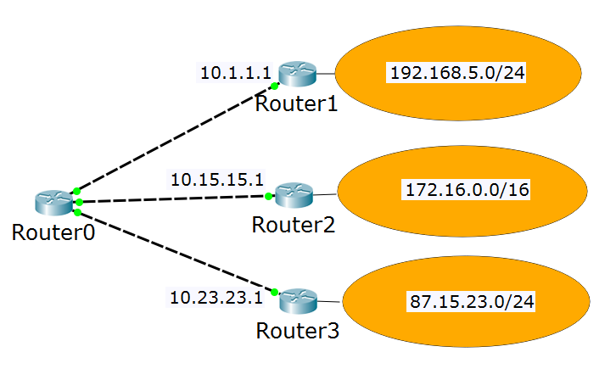
The Routing Table
My routing table:
192.168.5.0/24 via 10.1.1.1
172.16.0.0/16 via 10.15.15.1
87.15.23.0/24 via 10.23.23.1
10.1.1.0/24 is local
10.15.15.0/24 is local
10.23.23.0/24 is local
10.1.1.100
10.15.15.100
10.23.23.100

Slide 55
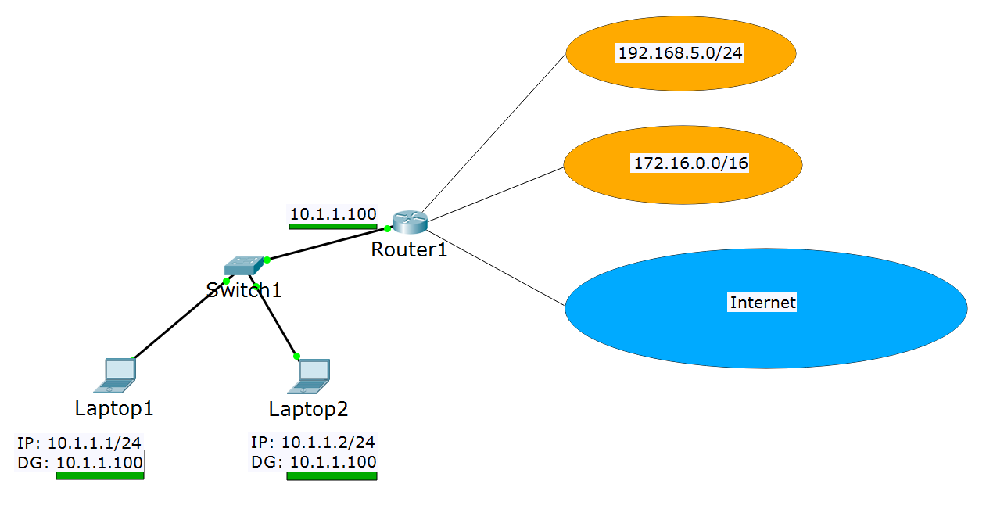
Default Gateway

Slide 56
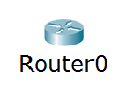
The Rule of the Longest Match
192.168.0.0/16 via 10.1.1.1
192.168.5.0/24 via 10.15.15.1
0.0.0.0/0 via 10.23.23.1
How do I reach 192.168.5.3?
How do I reach 192.168.18.7?
How do I reach 85.12.3.42?
Answer: via 10.15.15.1
Answer: via 10.1.1.1
Answer: via 10.23.23.1

Slide 57
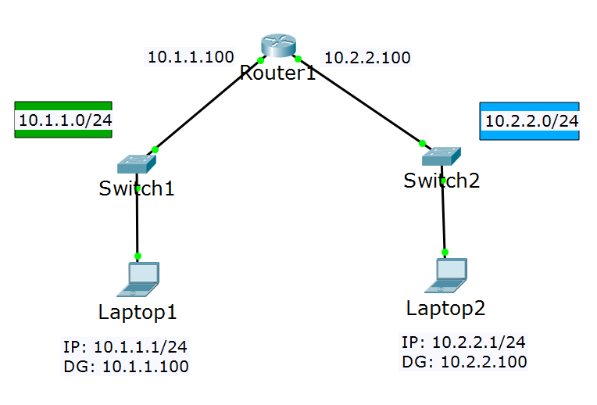
Direct routing

Slide 58
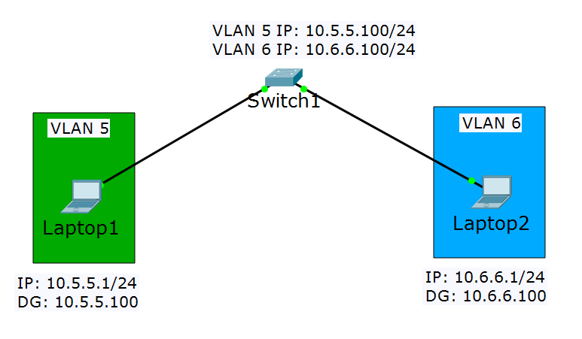
Inter-VLAN Routing Using the Same Switch

Slide 59
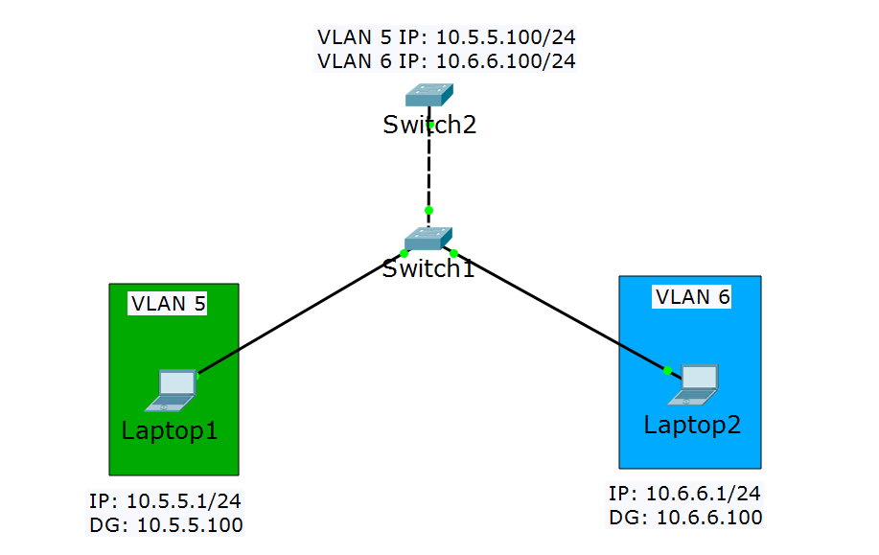
Inter-VLAN Routing Using External Switch
(This is L3 switch)
Trunk ports
(This is L2 switch)

Slide 60
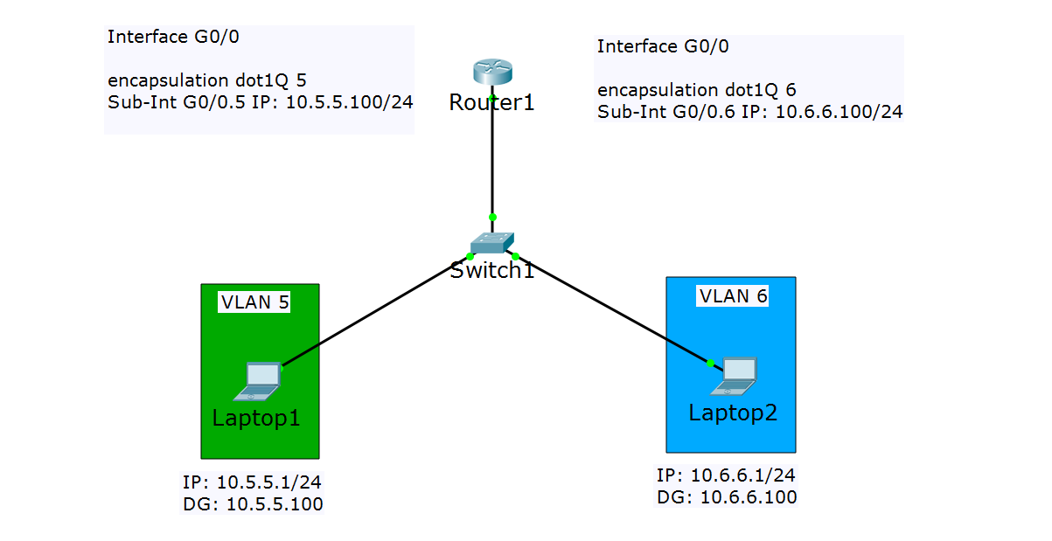
Inter-VLAN Routing Using External Router (2)
Trunk port

Slide 61
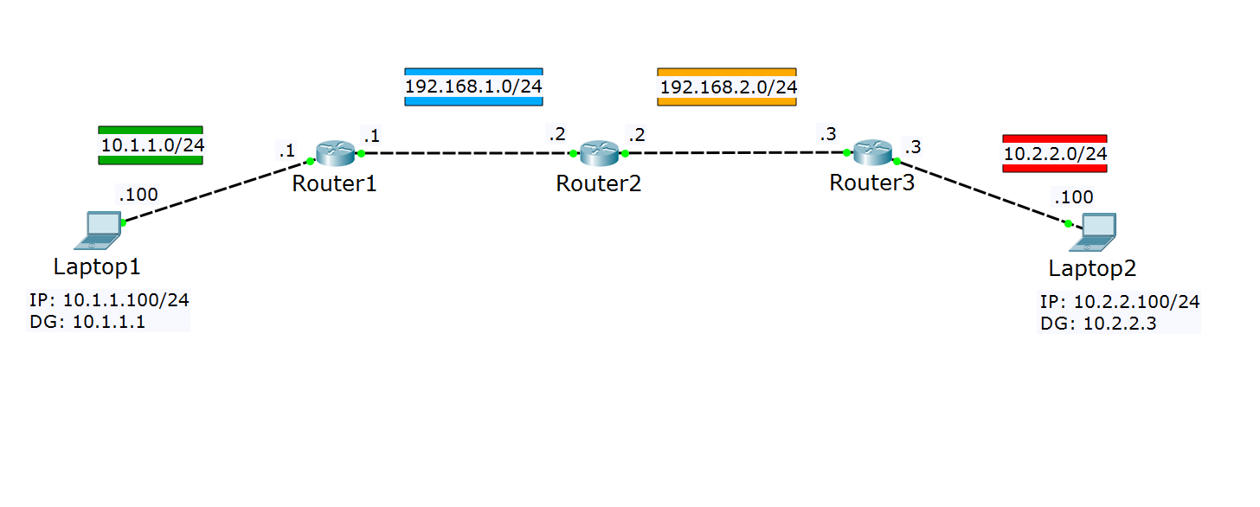
Static Routes
10.1.1.0/24 is local
192.168.1.0/24 is local
192.168.1.0/24 is local
192.168.2.0/24 is local
192.168.2.0/24 is local
10.2.2.0/24 is local
192.168.2.0/24 via 192.168.1.2
10.2.2.0/24 via 192.168.1.2
10.1.1.0/24 via 192.168.1.1
10.2.2.0/24 via 192.168.2.3
10.1.1.0/24 via 192.168.2.2
192.168.1.0/24 via 192.168.2.2

Slide 62
Lecture 6: Dynamic routing with OSPF

Slide 63
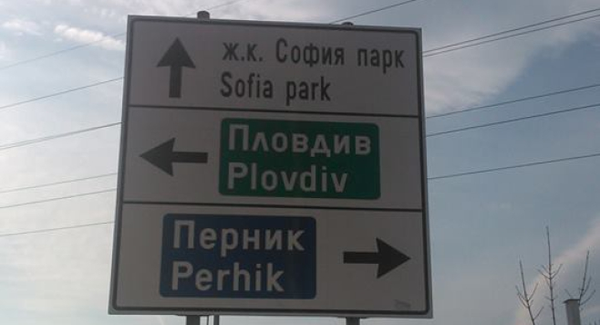
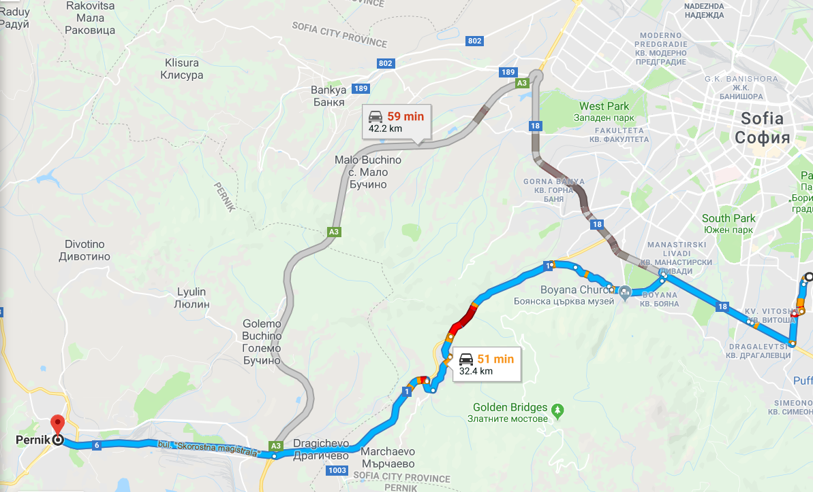
Distance-vector vs link-state protocols
Distance-vector protocols
Link-state protocols

Slide 64
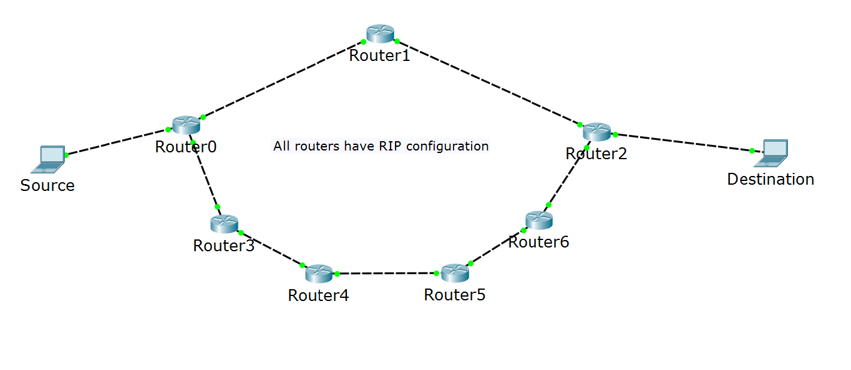
RIP Metric: hop count
Note: all routers talk RIP
I know how to reach Destination!
I will use Router1!
I know how to reach Destination!

Slide 65
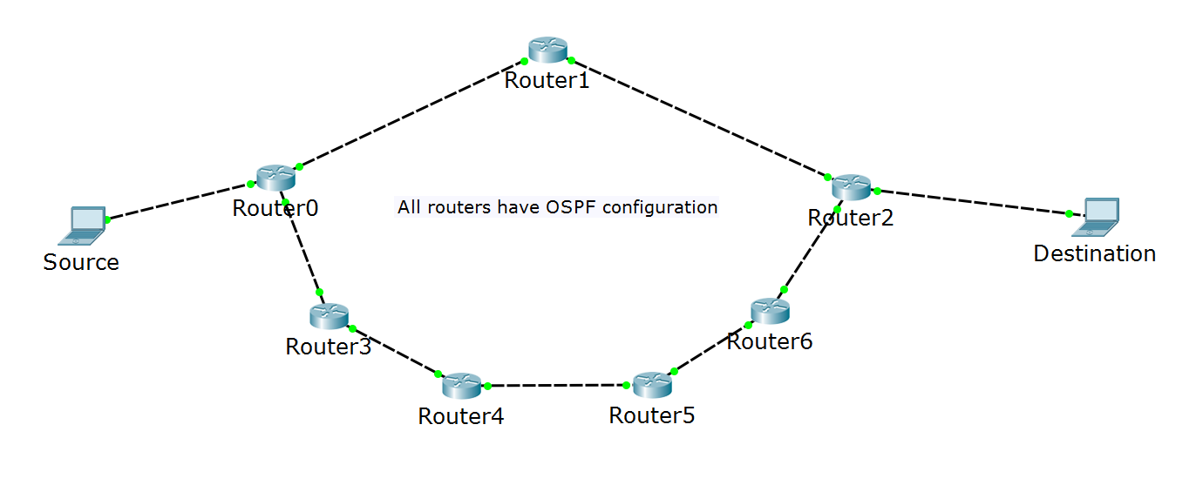
OSPF Metric: cost
Note: all routers talk OSPF
I know how to reach Destination!
I will use Router3!
slow links
fast links
I know how to reach Destination!

Slide 66
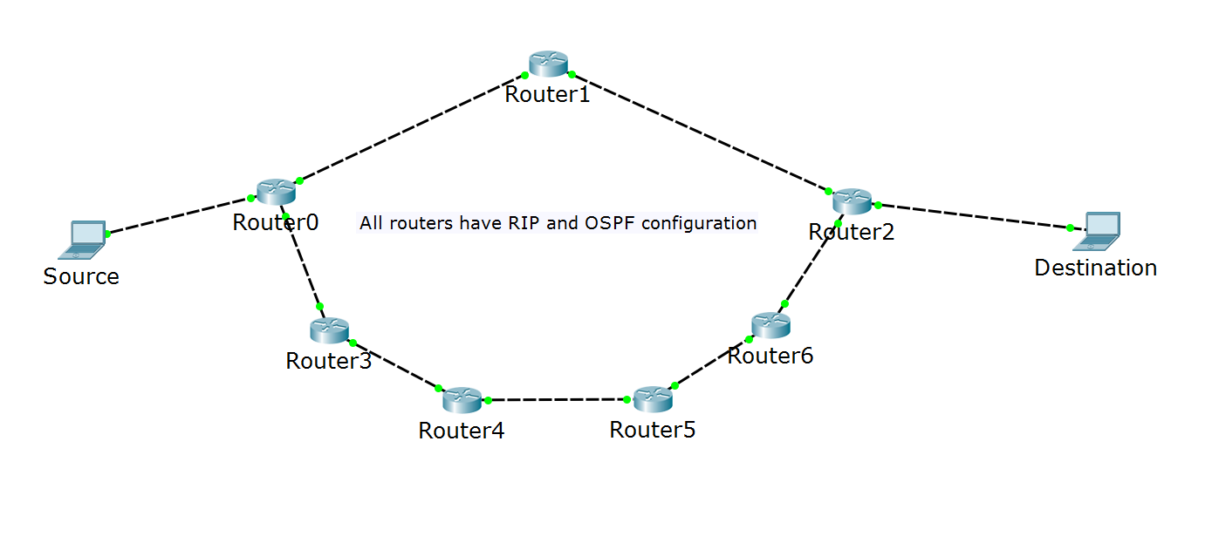
Multiple protocols in the same network
Note: all routers talk RIP and OSPF
RIP: I am better to reach Destination!
?
slow links
fast links
OSPF: I am better to reach Destination!

Slide 67
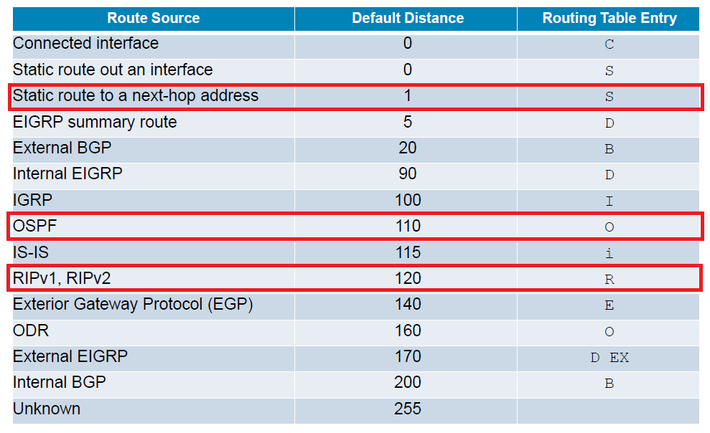
Administrative distance

Slide 68
Wildcard masks
In the subnet masks, 1 means “do care” and 0 means “don’t care”
Examples:
192.168.1.0 255.255.255.0 -> refers to 192.168.1.0 network
Loopback address: 10.1.1.1 255.255.255.255 -> exact IP address
In the wildcard masks, 0 means “do care” and 1 means “don’t care”
Examples:
192.168.1.0 0.0.0.255 -> refers to 192.168.1.0 network
Loopback address: 10.1.1.1 0.0.0.0 -> exact IP address

Slide 69
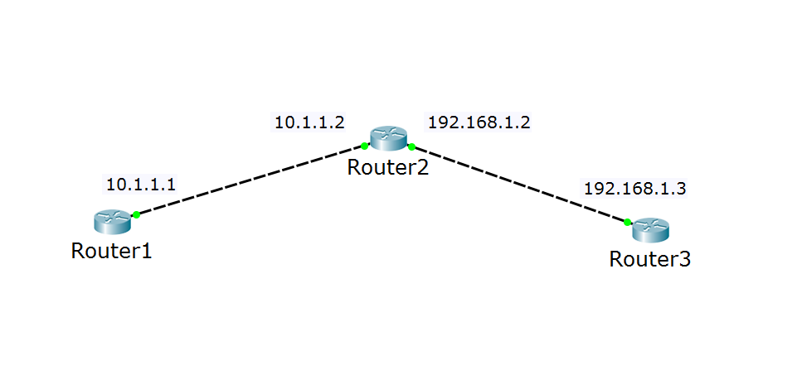
OSPF terms: router ID
I have many names (interfaces), but just call me 2.2.2.2
Hi, 2.2.2.2!
Hi, 2.2.2.2!

Slide 70
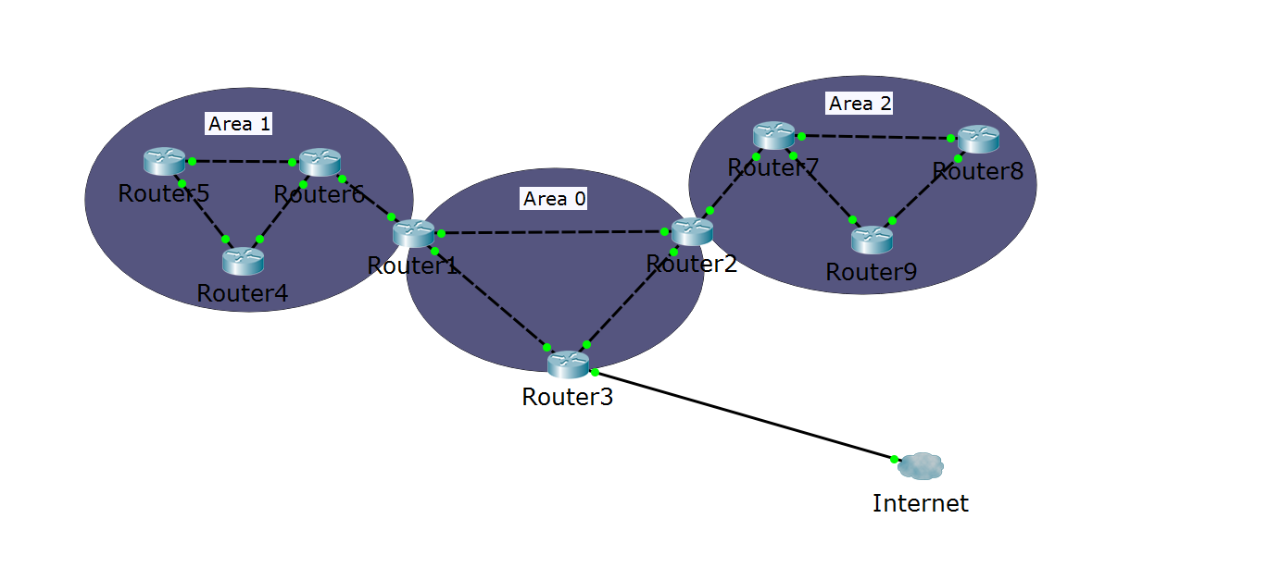
OSPF terms
Autonomous system
ABR
ABR
ASBR
Area 0 = the backbone area

Slide 71
Single area OSPF configuration
Minimum configuration:
router ospf process_id
router-id number (optional)
network A.B.C.D wildcard_mask area number
Example:
router ospf 1
router-id 1.1.1.1 (optional)
network 192.168.1.0 0.0.0.255 area 0
network 10.0.0.0 0.0.0.255 area 0

Slide 72
OSPF passive interface
The “network” command advertises the network AND sends hello messages out of the interface
What if there is non-OSPF device on the other end of the link?
The Hello packets will be useless
Represents security issues
One solution: use passive interfaces

Slide 73
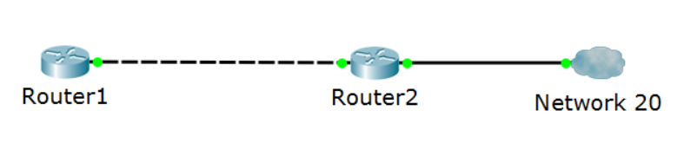




OSPF passive interface (2)
R1:
network 10.0.0.0 0.0.0.255
20.0.0.1
10.0.0.1
10.0.0.2
G0/1
R2:
network 10.0.0.0 0.0.0.255
network 20.0.0.0 0.0.0.255
Hello!
Hello!
I have network 10!
I have network 10!
…and 20!
Hello!
passive-interface G0/1
I have network 10 and 20!

Slide 74
Lecture 7: Demonstrations with physical devices

Slide 75










VLAN 5 (guest): 10.5.5.0/24
Internet
VLAN 10 (corporate): 10.10.10.0/24
Corporate WEB and DNS Server
SSID:
NetFund-Guest
SSID:
NetFund-Corporate
ge1/0/3
ether 1
fa0/1
fa0/2
ge1/0/1
ge1/0/2
ether 5
Ruckus AP
ZoneFlex 7363
Cisco 3560 PoE
3COM
MikroTik
RB951Ui-2HnD
Demo - scenario 1

Slide 76
Topology details – scenario 1
DHCP server for both VLANs is the Cisco device
MikroTik is routing the VLANs and making NAT to “outside”
Device, interface | IP address
Cisco, VLAN 5 | 10.5.5.3
Cisco, VLAN 10 | 10.10.10.3
HP, VLAN 5 | (10.5.5.2)
HP, VLAN 10 | (10.10.10.2)
Corporate server (Web and DNS) | 10.10.10.101
MikroTik, VLAN 5 | 10.5.5.1
MikroTik, VLAN 10 | 10.10.10.1

Slide 77
VLAN 5 (guest): 10.5.5.0/24
Corporate WEB and DNS Server
DHCP
Internet
VLAN 10 (corporate): 10.10.10.0/24
SSID:
NetFund-Guest
SSID:
NetFund-Corporate
10.13.13.0/24
fa0/3
ether 1
fa0/1
fa0/2
10.23.23.0/24
ether 5
Ruckus AP
ZoneFlex 7363
Cisco 3560 PoE
MikroTik
RB951Ui-2HnD
Demo - scenario 2

Slide 78
Topology details – scenario 2
DHCP server for both VLANs is the (Windows) Server
Cisco is routing the VLANs, MikroTik is making NAT to “outside”
Device, interface | IP address
Cisco, VLAN 5 | 10.5.5.3
Cisco, VLAN 10 | 10.10.10.3
Cisco, fa0/3 | 10.13.13.3
Cisco, fa0/2 | 10.23.23.3
Corporate server (Web and DNS) | 10.13.13.101
MikroTik, ether 5 | 10.23.23.1

Slide 79

Summary
1. Lecture 1: Introduction to networking
2. Lecture 2: IP addresses and host-to-host communication
3. Lecture 3: Network access, security and VLANS
4. Lecture 4: Layer 2 redundancy – STP
5. Lecture 5: IP services and basic routing
6. Lecture 6: Dynamic routing with OSPF
7. Lecture 7: Practice – Demonstrations with physical devices
…
…
…

Slide 81












SoftUni Diamond Partners

Slide 82


Educational Partners

Slide 83
Trainings @ Software University (SoftUni)
Software University – High-Quality Education, Profession and Job for Software Developers
softuni.bg, about.softuni.bg
Software University Foundation
softuni.foundation
Software University @ Facebook
facebook.com/SoftwareUniversity
Software University Forums
forum.softuni.bg
Notes:
83

